Slide 1





Joint Multisided Exposure Fairness for Search and Recommendation
Joint work with Haolun Wu, Chen Ma, Fernando Diaz, and Xue Liu
(Paper accepted @ SIGIR’22)
Pre-print: https://arxiv.org/pdf/2205.00048.pdf
Bhaskar Mitra
Microsoft Research, Canada
bmitra@microsoft.com

Slide 2

Digital information access and exposure
Traditional IR is concerned with ranking of items according to relevance
These information access systems deployed at web-scale mediate what information gets exposure
The exposure-framing of IR raises several fairness concerns, new opportunities for ranking optimization, and can be relevant to other FATE considerations (e.g., privacy and transparency)

Slide 3
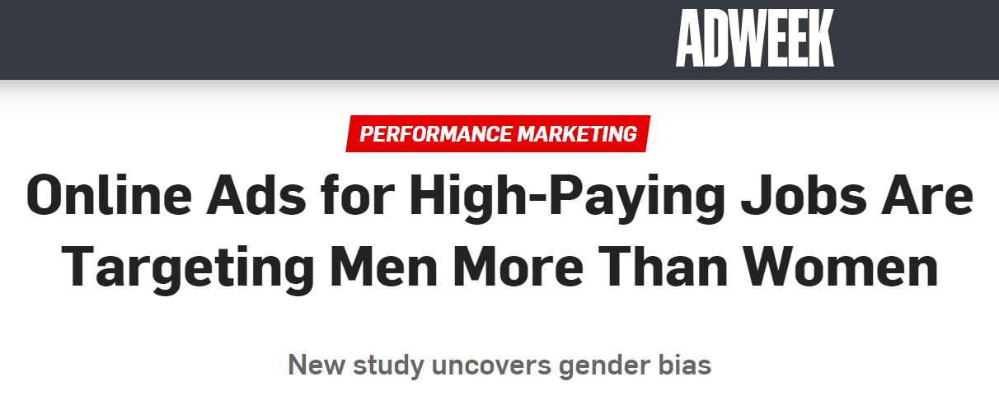
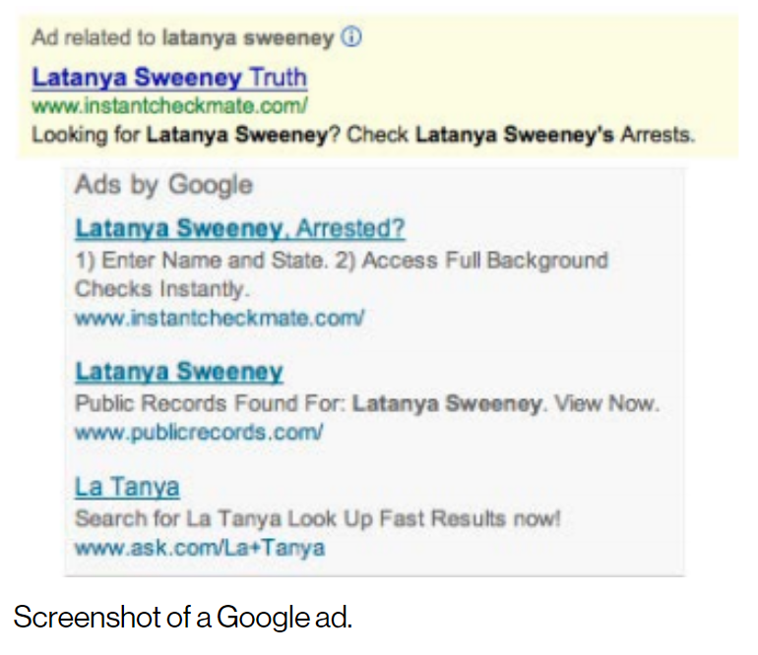
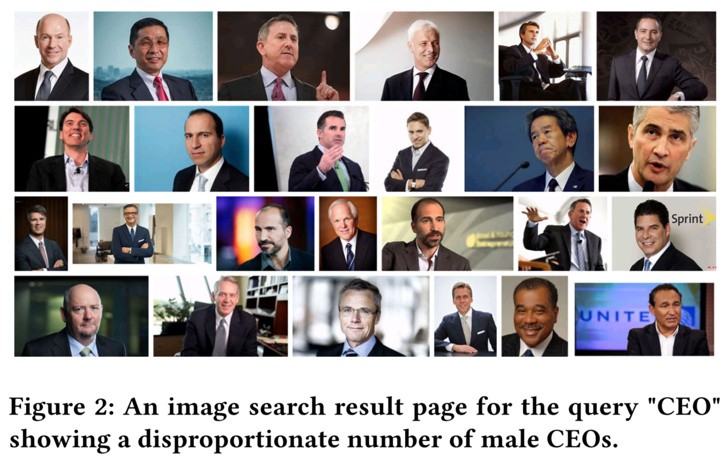
Harms of disparate exposure
Several past studies have pointed out representational and allocative harms from disparate exposure
Concerns of fairness in the context of IR/ML systems are inherently interdisciplinary and sociotechnical; and these concerns span beyond just questions of system design
The role of IR/ML in this process is to deconstruct their own measures and models in ways that allows a broad range of researchers and stakeholders to critically analyze and shape these technologies
In traditional IR, we have made progress in modeling, measuring, and optimizing for individual user satisfaction; a key challenge ahead is to model, measure, and optimize IR systems with respect to impact on populations of users and consider disparate impact across subpopulations
Sweeney. Discrimination in online ad delivery. Commun. ACM. (2013)
Crawford. The Trouble with Bias. NeurIPS. (2017)
Singh and Joachims. Fairness of Exposure in Rankings. In KDD, ACM. (2018)

Slide 4
Exposure fairness is a multisided problem
It is important to ask not just whether specific content receives exposure, but who it is exposed to and in what context
Haolun, Mitra, Ma, and Liu. Joint Multisided Exposure Fairness for Recommendation. Under review for SIGIR, ACM. (2022)

Slide 5




Exposure fairness is a multisided problem
Take the example of a job recommendation system
Individual-user-to-Individual-item fairness (II-F)
Are Individual items under/over-exposed to Individual users?
Individual-user-to-group-of-items fairness (IG-F)
Are groups of items under/over-exposed to individual users?
E.g., a specific user being disproportionately recommended low-paying jobs.
Group-of-users-to-Individual-item fairness (GI-F)
Are Individual items under/over-exposed to groups of users?
E.g., a specific job being disproportionately recommended to men and not to women and non-binary people.
Group-of-users-to-group-of-items fairness (GG-F)
Are groups of items under/over-exposed to groups of users?
E.g., men being disproportionately recommended high-paying jobs and women low-paying jobs.
All-users-to-Individual-item fairness (AI-F)
Are Individual items under/over-exposed to all users overall?
E.g., a specific job being disproportionately under-exposed to all users.
All-users-to-group-of-items fairness (AG-F)
Are groups of items under/over-exposed to all users overall?
E.g., jobs at Black-owned businesses being disproportionately under-exposed to all users.

Slide 6
Exposure fairness is a multisided problem
Take the example of a job recommendation system
Individual-user-to-Individual-item fairness (II-F)
Are Individual items under/over-exposed to Individual users?
Individual-user-to-group-of-items fairness (IG-F)
Are groups of items under/over-exposed to individual users?
E.g., a specific user being disproportionately recommended low-paying jobs.
Group-of-users-to-Individual-item fairness (GI-F)
Are Individual items under/over-exposed to groups of users?
E.g., a specific job being disproportionately recommended to men and not to women and non-binary people.
Group-of-users-to-group-of-items fairness (GG-F)
Are groups of items under/over-exposed to groups of users?
E.g., men being disproportionately recommended high-paying jobs and women low-paying jobs.
All-users-to-Individual-item fairness (AI-F)
Are Individual items under/over-exposed to all users overall?
E.g., a specific job being disproportionately under-exposed to all users.
All-users-to-group-of-items fairness (AG-F)
Are groups of items under/over-exposed to all users overall?
E.g., jobs at Black-owned businesses being disproportionately under-exposed to all users.

Slide 7
Exposure fairness is a multisided problem
Take the example of a job recommendation system
Individual-user-to-Individual-item fairness (II-F)
Are Individual items under/over-exposed to Individual users?
Individual-user-to-group-of-items fairness (IG-F)
Are groups of items under/over-exposed to individual users?
E.g., a specific user being disproportionately recommended low-paying jobs.
Group-of-users-to-Individual-item fairness (GI-F)
Are Individual items under/over-exposed to groups of users?
E.g., a specific job being disproportionately recommended to men and not to women and non-binary people.
Group-of-users-to-group-of-items fairness (GG-F)
Are groups of items under/over-exposed to groups of users?
E.g., men being disproportionately recommended high-paying jobs and women low-paying jobs.
All-users-to-Individual-item fairness (AI-F)
Are Individual items under/over-exposed to all users overall?
E.g., a specific job being disproportionately under-exposed to all users.
All-users-to-group-of-items fairness (AG-F)
Are groups of items under/over-exposed to all users overall?
E.g., jobs at Black-owned businesses being disproportionately under-exposed to all users.

Slide 8
Exposure fairness is a multisided problem
Take the example of a job recommendation system
Individual-user-to-Individual-item fairness (II-F)
Are Individual items under/over-exposed to Individual users?
Individual-user-to-group-of-items fairness (IG-F)
Are groups of items under/over-exposed to individual users?
E.g., a specific user being disproportionately recommended low-paying jobs.
Group-of-users-to-Individual-item fairness (GI-F)
Are Individual items under/over-exposed to groups of users?
E.g., a specific job being disproportionately recommended to men and not to women and non-binary people.
Group-of-users-to-group-of-items fairness (GG-F)
Are groups of items under/over-exposed to groups of users?
E.g., men being disproportionately recommended high-paying jobs and women low-paying jobs.
All-users-to-Individual-item fairness (AI-F)
Are Individual items under/over-exposed to all users overall?
E.g., a specific job being disproportionately under-exposed to all users.
All-users-to-group-of-items fairness (AG-F)
Are groups of items under/over-exposed to all users overall?
E.g., jobs at Black-owned businesses being disproportionately under-exposed to all users.

Slide 9
Exposure fairness is a multisided problem
Take the example of a job recommendation system
Individual-user-to-Individual-item fairness (II-F)
Are Individual items under/over-exposed to Individual users?
Individual-user-to-group-of-items fairness (IG-F)
Are groups of items under/over-exposed to individual users?
E.g., a specific user being disproportionately recommended low-paying jobs.
Group-of-users-to-Individual-item fairness (GI-F)
Are Individual items under/over-exposed to groups of users?
E.g., a specific job being disproportionately recommended to men and not to women and non-binary people.
Group-of-users-to-group-of-items fairness (GG-F)
Are groups of items under/over-exposed to groups of users?
E.g., men being disproportionately recommended high-paying jobs and women low-paying jobs.
All-users-to-Individual-item fairness (AI-F)
Are Individual items under/over-exposed to all users overall?
E.g., a specific job being disproportionately under-exposed to all users.
All-users-to-group-of-items fairness (AG-F)
Are groups of items under/over-exposed to all users overall?
E.g., jobs at Black-owned businesses being disproportionately under-exposed to all users.

Slide 10
Exposure fairness is a multisided problem
Take the example of a job recommendation system
Individual-user-to-Individual-item fairness (II-F)
Are Individual items under/over-exposed to Individual users?
Individual-user-to-group-of-items fairness (IG-F)
Are groups of items under/over-exposed to individual users?
E.g., a specific user being disproportionately recommended low-paying jobs.
Group-of-users-to-Individual-item fairness (GI-F)
Are Individual items under/over-exposed to groups of users?
E.g., a specific job being disproportionately recommended to men and not to women and non-binary people.
Group-of-users-to-group-of-items fairness (GG-F)
Are groups of items under/over-exposed to groups of users?
E.g., men being disproportionately recommended high-paying jobs and women low-paying jobs.
All-users-to-Individual-item fairness (AI-F)
Are Individual items under/over-exposed to all users overall?
E.g., a specific job being disproportionately under-exposed to all users.
All-users-to-group-of-items fairness (AG-F)
Are groups of items under/over-exposed to all users overall?
E.g., jobs at Black-owned businesses being disproportionately under-exposed to all users.

Slide 11
Exposure fairness is a multisided problem
Take the example of a job recommendation system
Individual-user-to-Individual-item fairness (II-F)
Are Individual items under/over-exposed to Individual users?
Individual-user-to-group-of-items fairness (IG-F)
Are groups of items under/over-exposed to individual users?
E.g., a specific user being disproportionately recommended low-paying jobs.
Group-of-users-to-Individual-item fairness (GI-F)
Are Individual items under/over-exposed to groups of users?
E.g., a specific job being disproportionately recommended to men and not to women and non-binary people.
Group-of-users-to-group-of-items fairness (GG-F)
Are groups of items under/over-exposed to groups of users?
E.g., men being disproportionately recommended high-paying jobs and women low-paying jobs.
All-users-to-Individual-item fairness (AI-F)
Are Individual items under/over-exposed to all users overall?
E.g., a specific job being disproportionately under-exposed to all users.
All-users-to-group-of-items fairness (AG-F)
Are groups of items under/over-exposed to all users overall?
E.g., jobs at Black-owned businesses being disproportionately under-exposed to all users.

Slide 12
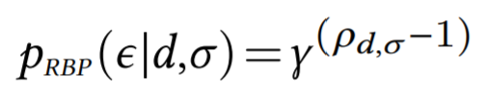
User browsing models and exposure
User browsing models are simplified models of how users inspect and interact with retrieved results
It estimates the probability that the user inspects a particular item in a ranked list of items—i.e., the item is exposed to the user
In IR, user models have been implicitly and explicitly employed in metric definitions and for estimating relevance from historical logs of user behavior data
For example, let’s consider the RBP user model…
RBP
NDCG
Probability of exposure at different ranks according to NDCG and RBP user browsing models
exposure event
rank of the item in the ranked list
an item
patience factor
a ranked list of items

Slide 13
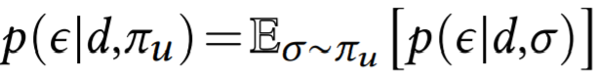
Stochastic ranking and expected exposure
In recommendation, Diaz et al. (2020) define a stochastic ranking policy 𝜋_{𝑢}, conditioned on user 𝑢 ∈ U, as a probability distribution over all permutations of items in the collection
The expected exposure of an item 𝑑 for user 𝑢 can then be computed as follows:
Here, 𝑝(𝜖|𝑑,𝜎) can be computed using a user browsing model like RBP as discussed previously
Note: The above formulation can also be applied to search by replacing user with query
Diaz, Mitra, Ekstrand, Biega, and Carterette. Evaluating stochastic rankings with expected exposure. In CIKM, ACM. (2020)

Slide 14
System, target, and random exposure
System exposure. The user-item expected exposure distribution corresponding to a stochastic ranking policy 𝜋. Correspondingly, we can define a |U|×|D| matrix E, such that E_{𝑖𝑗} = 𝑝(𝜖|D_{𝑗} ,𝜋_{U𝑖}).
Target exposure. The user-item expected exposure distribution corresponding to an ideal stochastic ranking policy 𝜋*, as defined by some desirable principle (e.g., the equal expected exposure principle). We denote the corresponding expected exposure matrix as E*.
Random exposure. The user-item expected exposure distribution corresponding to a stochastic ranking policy 𝜋~ that samples rankings from a uniform distribution over all item permutations. We denote the corresponding expected exposure matrix as E~.
The deviation of E from E* gives us a quantitative measure of the suboptimality of the retrieval system under consideration.

Slide 15
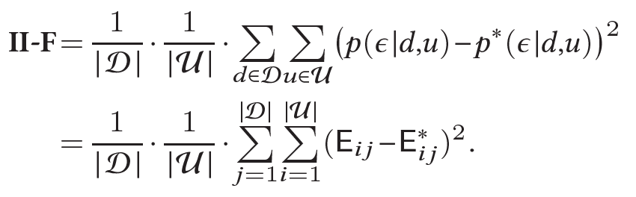
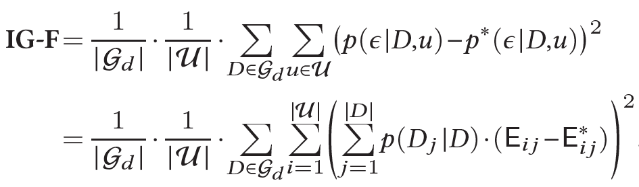
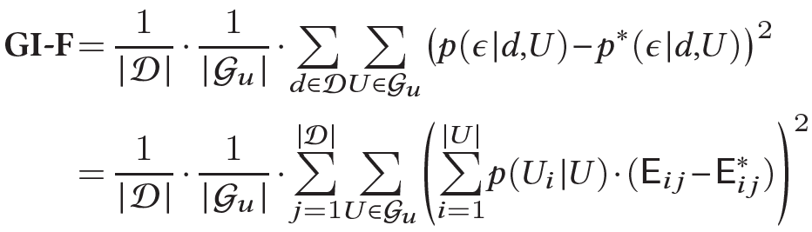
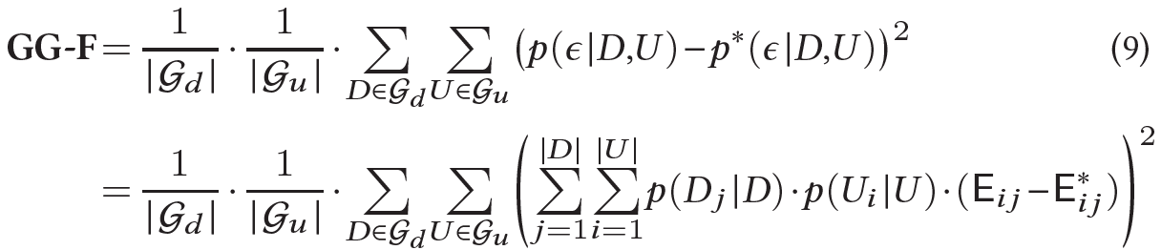
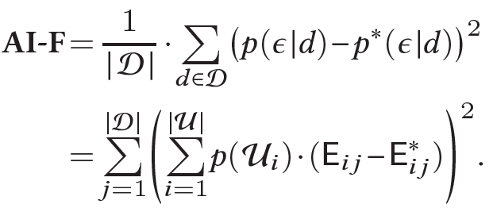
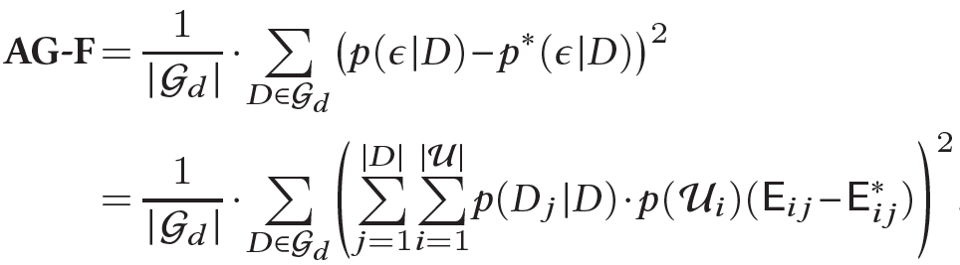
Joint multisided exposure (JME) fairness metrics
Haolun, Mitra, Ma, and Liu. Joint Multisided Exposure Fairness for Recommendation. Under review for SIGIR, ACM. (2022)

Slide 16
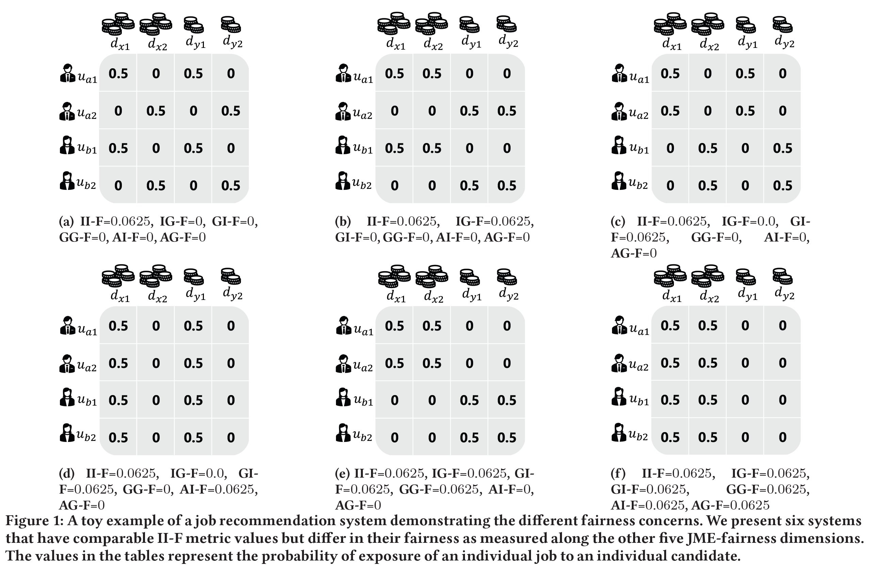
Toy example
Let, there be 4 candidates (𝑢_{𝑎1}, 𝑢_{𝑎2}, 𝑢_{𝑏1}, 𝑢_{𝑏2}) and 4 jobs (𝑑_{𝑥1}, 𝑑_{𝑥2}, 𝑑_{𝑦1}, 𝑑_{𝑦2})
All 4 jobs are relevant to each of the 4 candidates
The candidates belong to 2 groups 𝑎 (𝑢_{𝑎1}, 𝑢_{𝑎2}) and 𝑏 (𝑢_{𝑏1}, 𝑢_{𝑏2})—e.g., based on gender—and similarly the jobs belong to 2 groups 𝑥 (𝑑_{𝑥1}, 𝑑_{𝑥2}) and 𝑦 (𝑑_{𝑦1}, 𝑑_{𝑦2})—say based on whether they pay high or low salaries
Let’s assume that the recommender system displays only one result at a time and our simple user model assumes that the user always inspects the displayed result—i.e., the probability of exposure is 1 for the displayed item and 0 for all other items for a given impression
In this setting, an ideal recommender should expose each of the four jobs to each candidate with a probability of 0.25

Slide 17
Toy example
Let, there be 4 candidates (𝑢_{𝑎1}, 𝑢_{𝑎2}, 𝑢_{𝑏1}, 𝑢_{𝑏2}) and 4 jobs (𝑑_{𝑥1}, 𝑑_{𝑥2}, 𝑑_{𝑦1}, 𝑑_{𝑦2})
All 4 jobs are relevant to each of the 4 candidates
The candidates belong to 2 groups 𝑎 (𝑢_{𝑎1}, 𝑢_{𝑎2}) and 𝑏 (𝑢_{𝑏1}, 𝑢_{𝑏2})—e.g., based on gender—and similarly the jobs belong to 2 groups 𝑥 (𝑑_{𝑥1}, 𝑑_{𝑥2}) and 𝑦 (𝑑_{𝑦1}, 𝑑_{𝑦2})—say based on whether they pay high or low salaries
Let’s assume that the recommender system displays only one result at a time and our simple user model assumes that the user always inspects the displayed result—i.e., the probability of exposure is 1 for the displayed item and 0 for all other items for a given impression
In this setting, an ideal recommender should expose each of the four jobs to each candidate with a probability of 0.25
All of them are equally II-Unfair

Slide 18
Toy example
Let, there be 4 candidates (𝑢_{𝑎1}, 𝑢_{𝑎2}, 𝑢_{𝑏1}, 𝑢_{𝑏2}) and 4 jobs (𝑑_{𝑥1}, 𝑑_{𝑥2}, 𝑑_{𝑦1}, 𝑑_{𝑦2})
All 4 jobs are relevant to each of the 4 candidates
The candidates belong to 2 groups 𝑎 (𝑢_{𝑎1}, 𝑢_{𝑎2}) and 𝑏 (𝑢_{𝑏1}, 𝑢_{𝑏2})—e.g., based on gender—and similarly the jobs belong to 2 groups 𝑥 (𝑑_{𝑥1}, 𝑑_{𝑥2}) and 𝑦 (𝑑_{𝑦1}, 𝑑_{𝑦2})—say based on whether they pay high or low salaries
Let’s assume that the recommender system displays only one result at a time and our simple user model assumes that the user always inspects the displayed result—i.e., the probability of exposure is 1 for the displayed item and 0 for all other items for a given impression
In this setting, an ideal recommender should expose each of the four jobs to each candidate with a probability of 0.25
Only (b), (e), and (f) are IG-Unfair

Slide 19
Toy example
Let, there be 4 candidates (𝑢_{𝑎1}, 𝑢_{𝑎2}, 𝑢_{𝑏1}, 𝑢_{𝑏2}) and 4 jobs (𝑑_{𝑥1}, 𝑑_{𝑥2}, 𝑑_{𝑦1}, 𝑑_{𝑦2})
All 4 jobs are relevant to each of the 4 candidates
The candidates belong to 2 groups 𝑎 (𝑢_{𝑎1}, 𝑢_{𝑎2}) and 𝑏 (𝑢_{𝑏1}, 𝑢_{𝑏2})—e.g., based on gender—and similarly the jobs belong to 2 groups 𝑥 (𝑑_{𝑥1}, 𝑑_{𝑥2}) and 𝑦 (𝑑_{𝑦1}, 𝑑_{𝑦2})—say based on whether they pay high or low salaries
Let’s assume that the recommender system displays only one result at a time and our simple user model assumes that the user always inspects the displayed result—i.e., the probability of exposure is 1 for the displayed item and 0 for all other items for a given impression
In this setting, an ideal recommender should expose each of the four jobs to each candidate with a probability of 0.25
Only (c), (d), (e), and (f) are GI-Unfair

Slide 20
Toy example
Let, there be 4 candidates (𝑢_{𝑎1}, 𝑢_{𝑎2}, 𝑢_{𝑏1}, 𝑢_{𝑏2}) and 4 jobs (𝑑_{𝑥1}, 𝑑_{𝑥2}, 𝑑_{𝑦1}, 𝑑_{𝑦2})
All 4 jobs are relevant to each of the 4 candidates
The candidates belong to 2 groups 𝑎 (𝑢_{𝑎1}, 𝑢_{𝑎2}) and 𝑏 (𝑢_{𝑏1}, 𝑢_{𝑏2})—e.g., based on gender—and similarly the jobs belong to 2 groups 𝑥 (𝑑_{𝑥1}, 𝑑_{𝑥2}) and 𝑦 (𝑑_{𝑦1}, 𝑑_{𝑦2})—say based on whether they pay high or low salaries
Let’s assume that the recommender system displays only one result at a time and our simple user model assumes that the user always inspects the displayed result—i.e., the probability of exposure is 1 for the displayed item and 0 for all other items for a given impression
In this setting, an ideal recommender should expose each of the four jobs to each candidate with a probability of 0.25
Only (e) and (f) are GG-Unfair

Slide 21
Toy example
Let, there be 4 candidates (𝑢_{𝑎1}, 𝑢_{𝑎2}, 𝑢_{𝑏1}, 𝑢_{𝑏2}) and 4 jobs (𝑑_{𝑥1}, 𝑑_{𝑥2}, 𝑑_{𝑦1}, 𝑑_{𝑦2})
All 4 jobs are relevant to each of the 4 candidates
The candidates belong to 2 groups 𝑎 (𝑢_{𝑎1}, 𝑢_{𝑎2}) and 𝑏 (𝑢_{𝑏1}, 𝑢_{𝑏2})—e.g., based on gender—and similarly the jobs belong to 2 groups 𝑥 (𝑑_{𝑥1}, 𝑑_{𝑥2}) and 𝑦 (𝑑_{𝑦1}, 𝑑_{𝑦2})—say based on whether they pay high or low salaries
Let’s assume that the recommender system displays only one result at a time and our simple user model assumes that the user always inspects the displayed result—i.e., the probability of exposure is 1 for the displayed item and 0 for all other items for a given impression
In this setting, an ideal recommender should expose each of the four jobs to each candidate with a probability of 0.25
Only (d) and (f) are AI-Unfair

Slide 22
Toy example
Let, there be 4 candidates (𝑢_{𝑎1}, 𝑢_{𝑎2}, 𝑢_{𝑏1}, 𝑢_{𝑏2}) and 4 jobs (𝑑_{𝑥1}, 𝑑_{𝑥2}, 𝑑_{𝑦1}, 𝑑_{𝑦2})
All 4 jobs are relevant to each of the 4 candidates
The candidates belong to 2 groups 𝑎 (𝑢_{𝑎1}, 𝑢_{𝑎2}) and 𝑏 (𝑢_{𝑏1}, 𝑢_{𝑏2})—e.g., based on gender—and similarly the jobs belong to 2 groups 𝑥 (𝑑_{𝑥1}, 𝑑_{𝑥2}) and 𝑦 (𝑑_{𝑦1}, 𝑑_{𝑦2})—say based on whether they pay high or low salaries
Let’s assume that the recommender system displays only one result at a time and our simple user model assumes that the user always inspects the displayed result—i.e., the probability of exposure is 1 for the displayed item and 0 for all other items for a given impression
In this setting, an ideal recommender should expose each of the four jobs to each candidate with a probability of 0.25
Only (f) is AG-Unfair

Slide 23
Relationship between different JME metrics
II-F=0
Based on the metric definitions, we can show that a system that is II-Fair (i.e., II-F=0) will also be fair along the other five JME-fairness dimensions
Similarly, IG-Fair and GI-Fair independently implies GG-Fair, and GG-Fair and AI-Fair implies AG-Fair
Finally, all the other metrics can be viewed as specific instances of GG-F, with different (extreme) definitions of groups on user and item side
IG-F=0
GI-F=0
GG-F=0
AI-F=0
AG-F=0

Slide 24
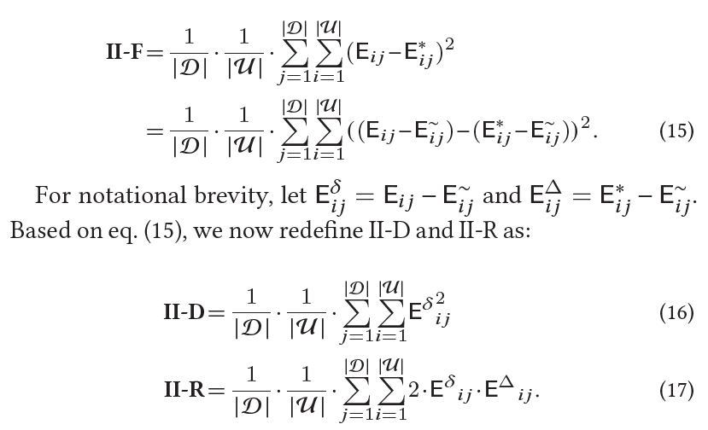
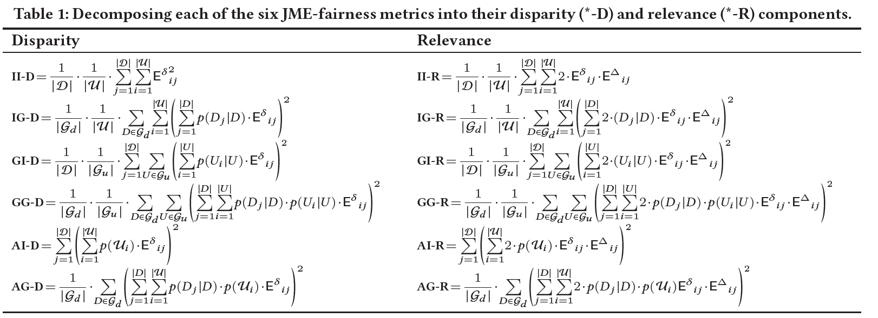
Disparity and relevance
Each of our proposed JME-fairness metrics can be decomposed into a disparity and a relevance component, such that increasing randomness in the model would decrease disparity (good!) but also decrease relevance (bad!)

Slide 25
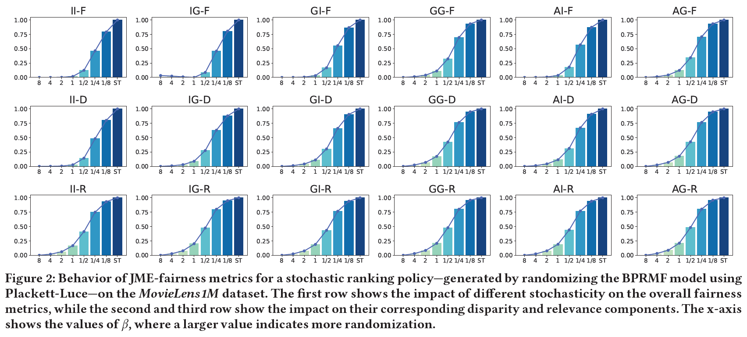
Disparity and relevance
Each of our proposed JME-fairness metrics can be decomposed into a disparity and a relevance component, such that increasing randomness in the model would decrease disparity (good!) but also decrease relevance (bad!)

Slide 26
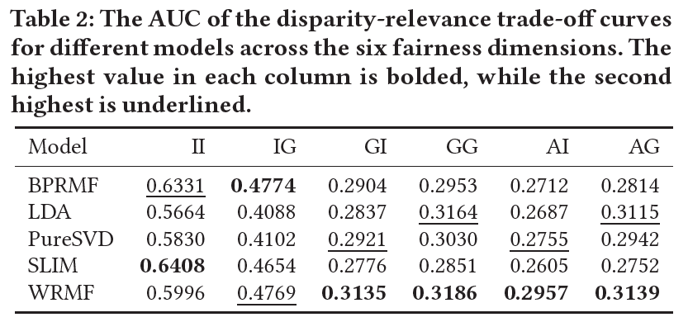
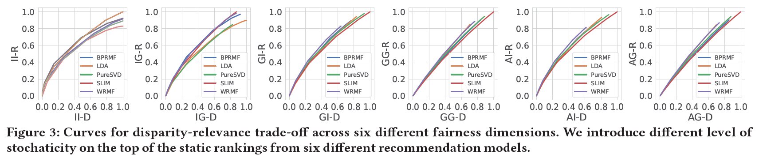
Disparity and relevance
Each of our proposed JME-fairness metrics can be decomposed into a disparity and a relevance component, such that increasing randomness in the model would decrease disparity (good!) but also decrease relevance (bad!)
Different models have different disparity-relevance trade-off for each of the different JME-fairness metrics

Slide 27
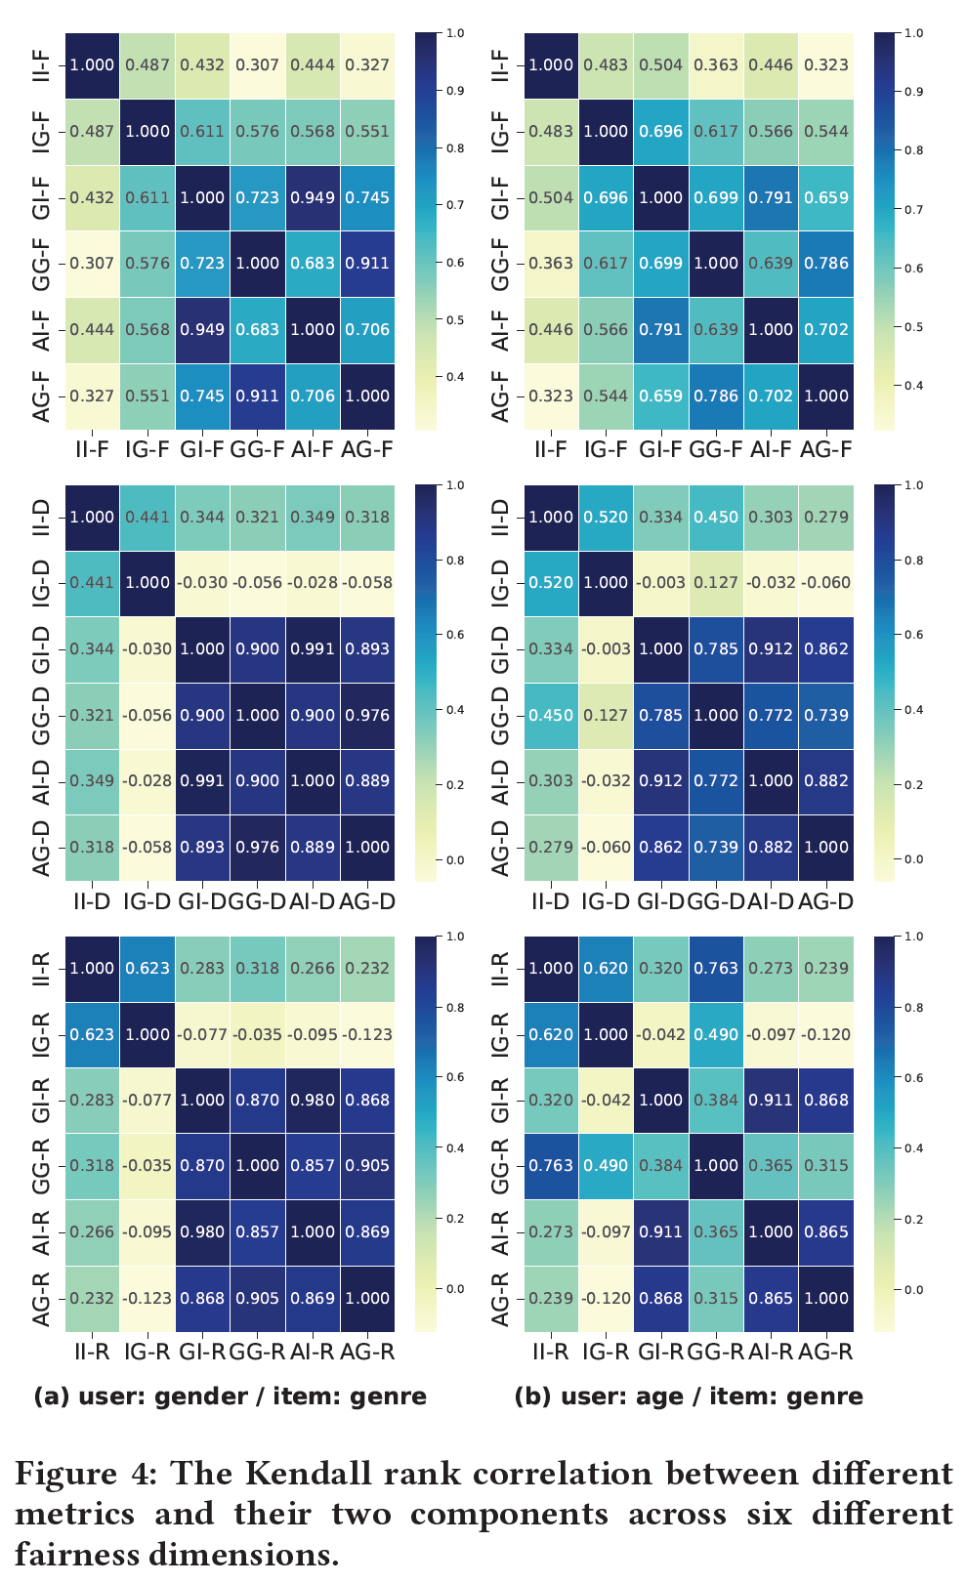
How correlated are different JME-fairness dimensions?
Recall that all six JME-Fairness metrics can be seen as specific instances of GG-F
For this analysis using MovieLens we had 2 groups by gender* and 7 groups by age on the user side and 18 genres on the item side
When we have small number of large groups “Individual” and “Group” analysis will diverge, and vice versa
* The gender attribute is available in the MovieLens dataset as a binary annotation. We recognize that this does not reflect the full spectrum of gender identities, and this is a short-coming of our work.

Slide 28
New metrics, new optimization opportunity!
How can we optimize ranking models for target exposure?
Diaz, Mitra, Ekstrand, Biega, and Carterette. Evaluating stochastic rankings with expected exposure. In CIKM, ACM. (2020)

Slide 29




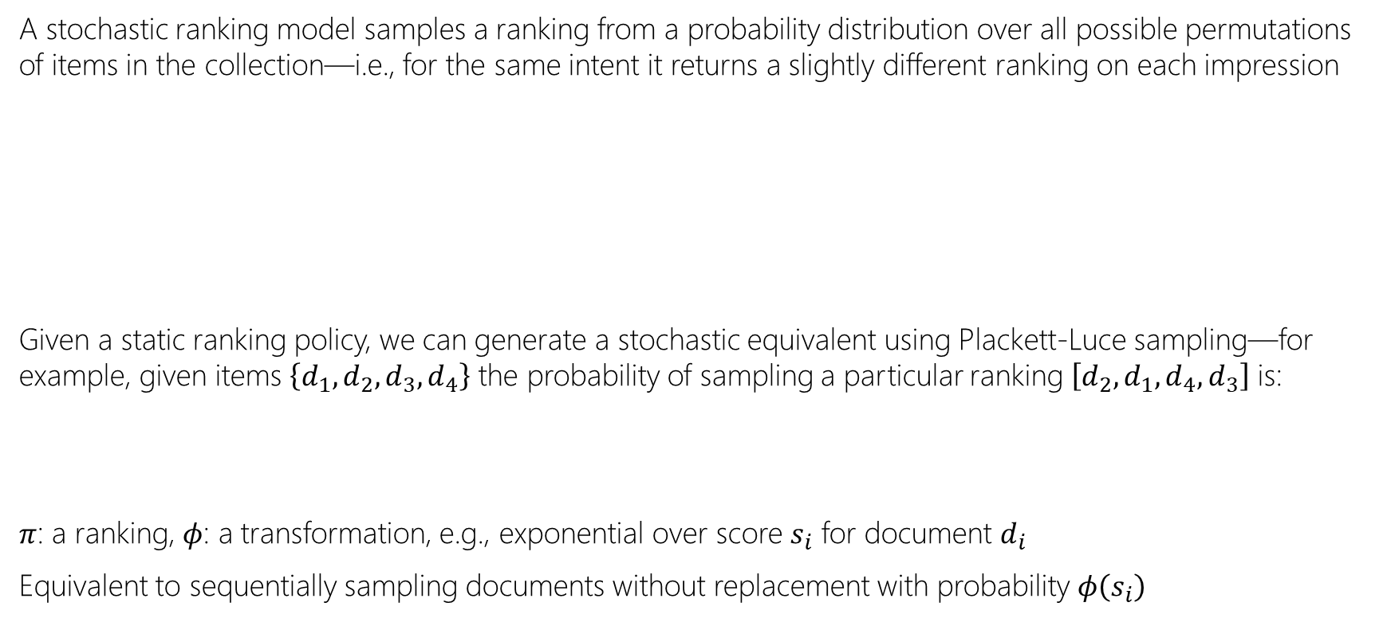
Stochastic ranking
A stochastic ranking model samples a ranking from a probability distribution over all possible permutations of items in the collection—i.e., for the same intent it returns a slightly different ranking on each impression
Given a static ranking policy, we can generate a stochastic equivalent using Plackett-Luce sampling—for example, given items $\left\{d_{1},d_{2},d_{3},d_{4}\right\}$ the probability of sampling a particular ranking $\left[d_{2},d_{1},d_{4},d_{3}\right]$ is:
$π$: a ranking, $φ$: a transformation, e.g., exponential over score $s_{i}$ for document $d_{i}$
Equivalent to sequentially sampling documents without replacement with probability $φ\left(s_{i}\right)$
restaurants in montreal
restaurants in montreal
restaurants in montreal
restaurants in montreal
Luce. Individual Choice Behavior. (1959)
Plackett. The Analysis of Permutations. Journal of the Royal Statistical Society: Series C (Applied Statistics). (1975)

Slide 30
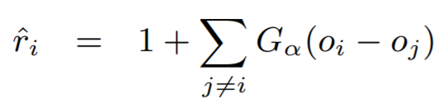
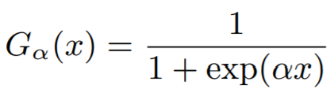
Gradient-based optimization for target exposure
Approach
Challenges and solutions
Use the target model to score the items
Compute PL sampling probability as a function of the item scores
Sample multiple rankings
Compute expected system exposure across sampled rankings
Compute the loss as a difference between system and target exposure
Backpropagate!
The key challenge is the proposed approach is that both the sampling and the ranking steps are non-differentiable!
For sampling, we can use Gumbel sampling as a differentiable approximation
For ranking, we can employ SmoothRank / ApproxRank as differentiable approximations of the ranking step
,
Wu, Chang, Zheng, and Zha. Smoothing DCG for learning to rank: A novel approach using smoothed hinge functions. In Proc. CIKM, ACM. (2009)
Qin, Liu, and Li. A general approximation framework for direct optimization of information retrieval measures. Information retrieval. (2010)
Bruch, Han, Bendersky, and Najork. A stochastic treatment of learning to rank scoring functions. In Proc. WSDM, ACM. (2020)

Slide 31








Gradient-based optimization for target exposure
items
neural scoring function
add independently sampled Gumbel noise
compute smooth rank value
compute exposure using user model
compute average exposure
compute loss with target exposure
target exposure
Diaz, Mitra, Ekstrand, Biega, and Carterette. Evaluating stochastic rankings with expected exposure. In CIKM, ACM. (2020)

Slide 32
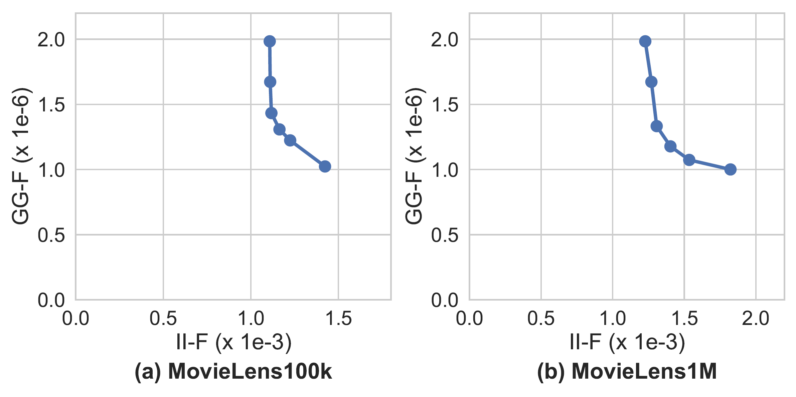
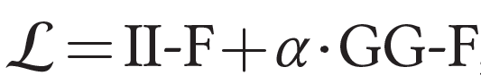
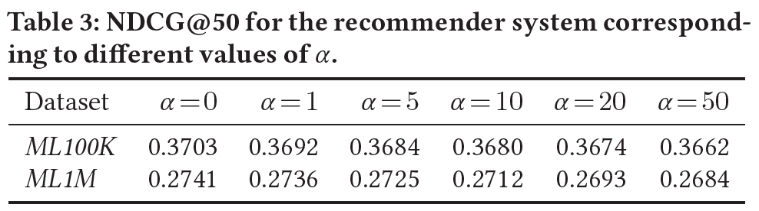
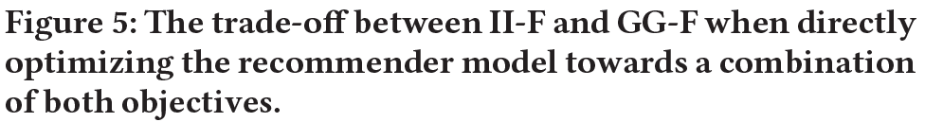
Trading-off different JME-fairness metrics
We can simultaneously optimize for multiple exposure metrics by combining them linearly
For example,
Preliminary experiments indicate that we can significantly minimize GG-F with minimal degradation to II-F and relevance

Slide 33
Discussion
True vs. observed relevance labels. The computation of target exposure itself raises fairness questions. E.g., the equal expected exposure principle assumes we have access to true relevance labels, but in fact the observed labels reflect huge historical social biases. E.g., In the job recommendation scenario, it may be more appropriate to define GG-F target exposure for high and low paying jobs to be uniform across user groups, irrespective of historical disparities reflected in the data.
Choice of group attributes. The choice of group attributes necessitates reflecting on historical and socioeconomic contexts. We note that our formulation can also be extended to handling multiple group attributes on each side. However, that raises questions of intersectional fairness that we haven’t yet studied in our work.
Beyond two-sided exposure fairness. While we have primarily focused on two-sided exposure fairness so far, we envision that extending that to additional stakeholder may also be important. E.g., in product search exposure fairness may concern with being fair to consumers, manufacturers, and retailers.
Incorporating model uncertainty. The stochastic ranking policies we have considered so far involves randomizing a static policy with model-independent sampling of noise. In contrast, the stochasticity could also be informed by the model’s own uncertainty in its prediction. This is an area for potential future work.

